Slide 1
What are the four ways to create wealth?

Slide 2
Land
Labor
Capital
Entrepreneurship

Slide 3
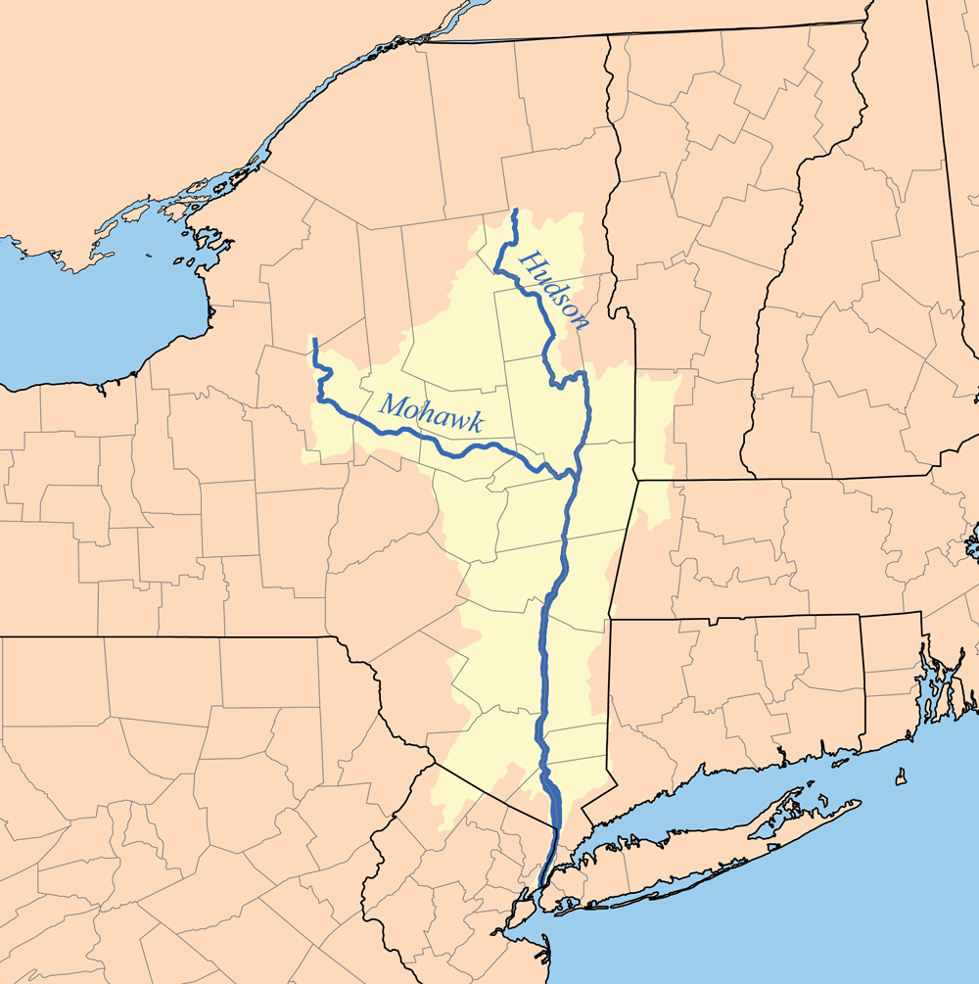
Hudson River Valley: New York
1839
Calico Indians (Boston Tea Party)
Land, Labor, Capital
Anti-Rent Movement

Slide 4
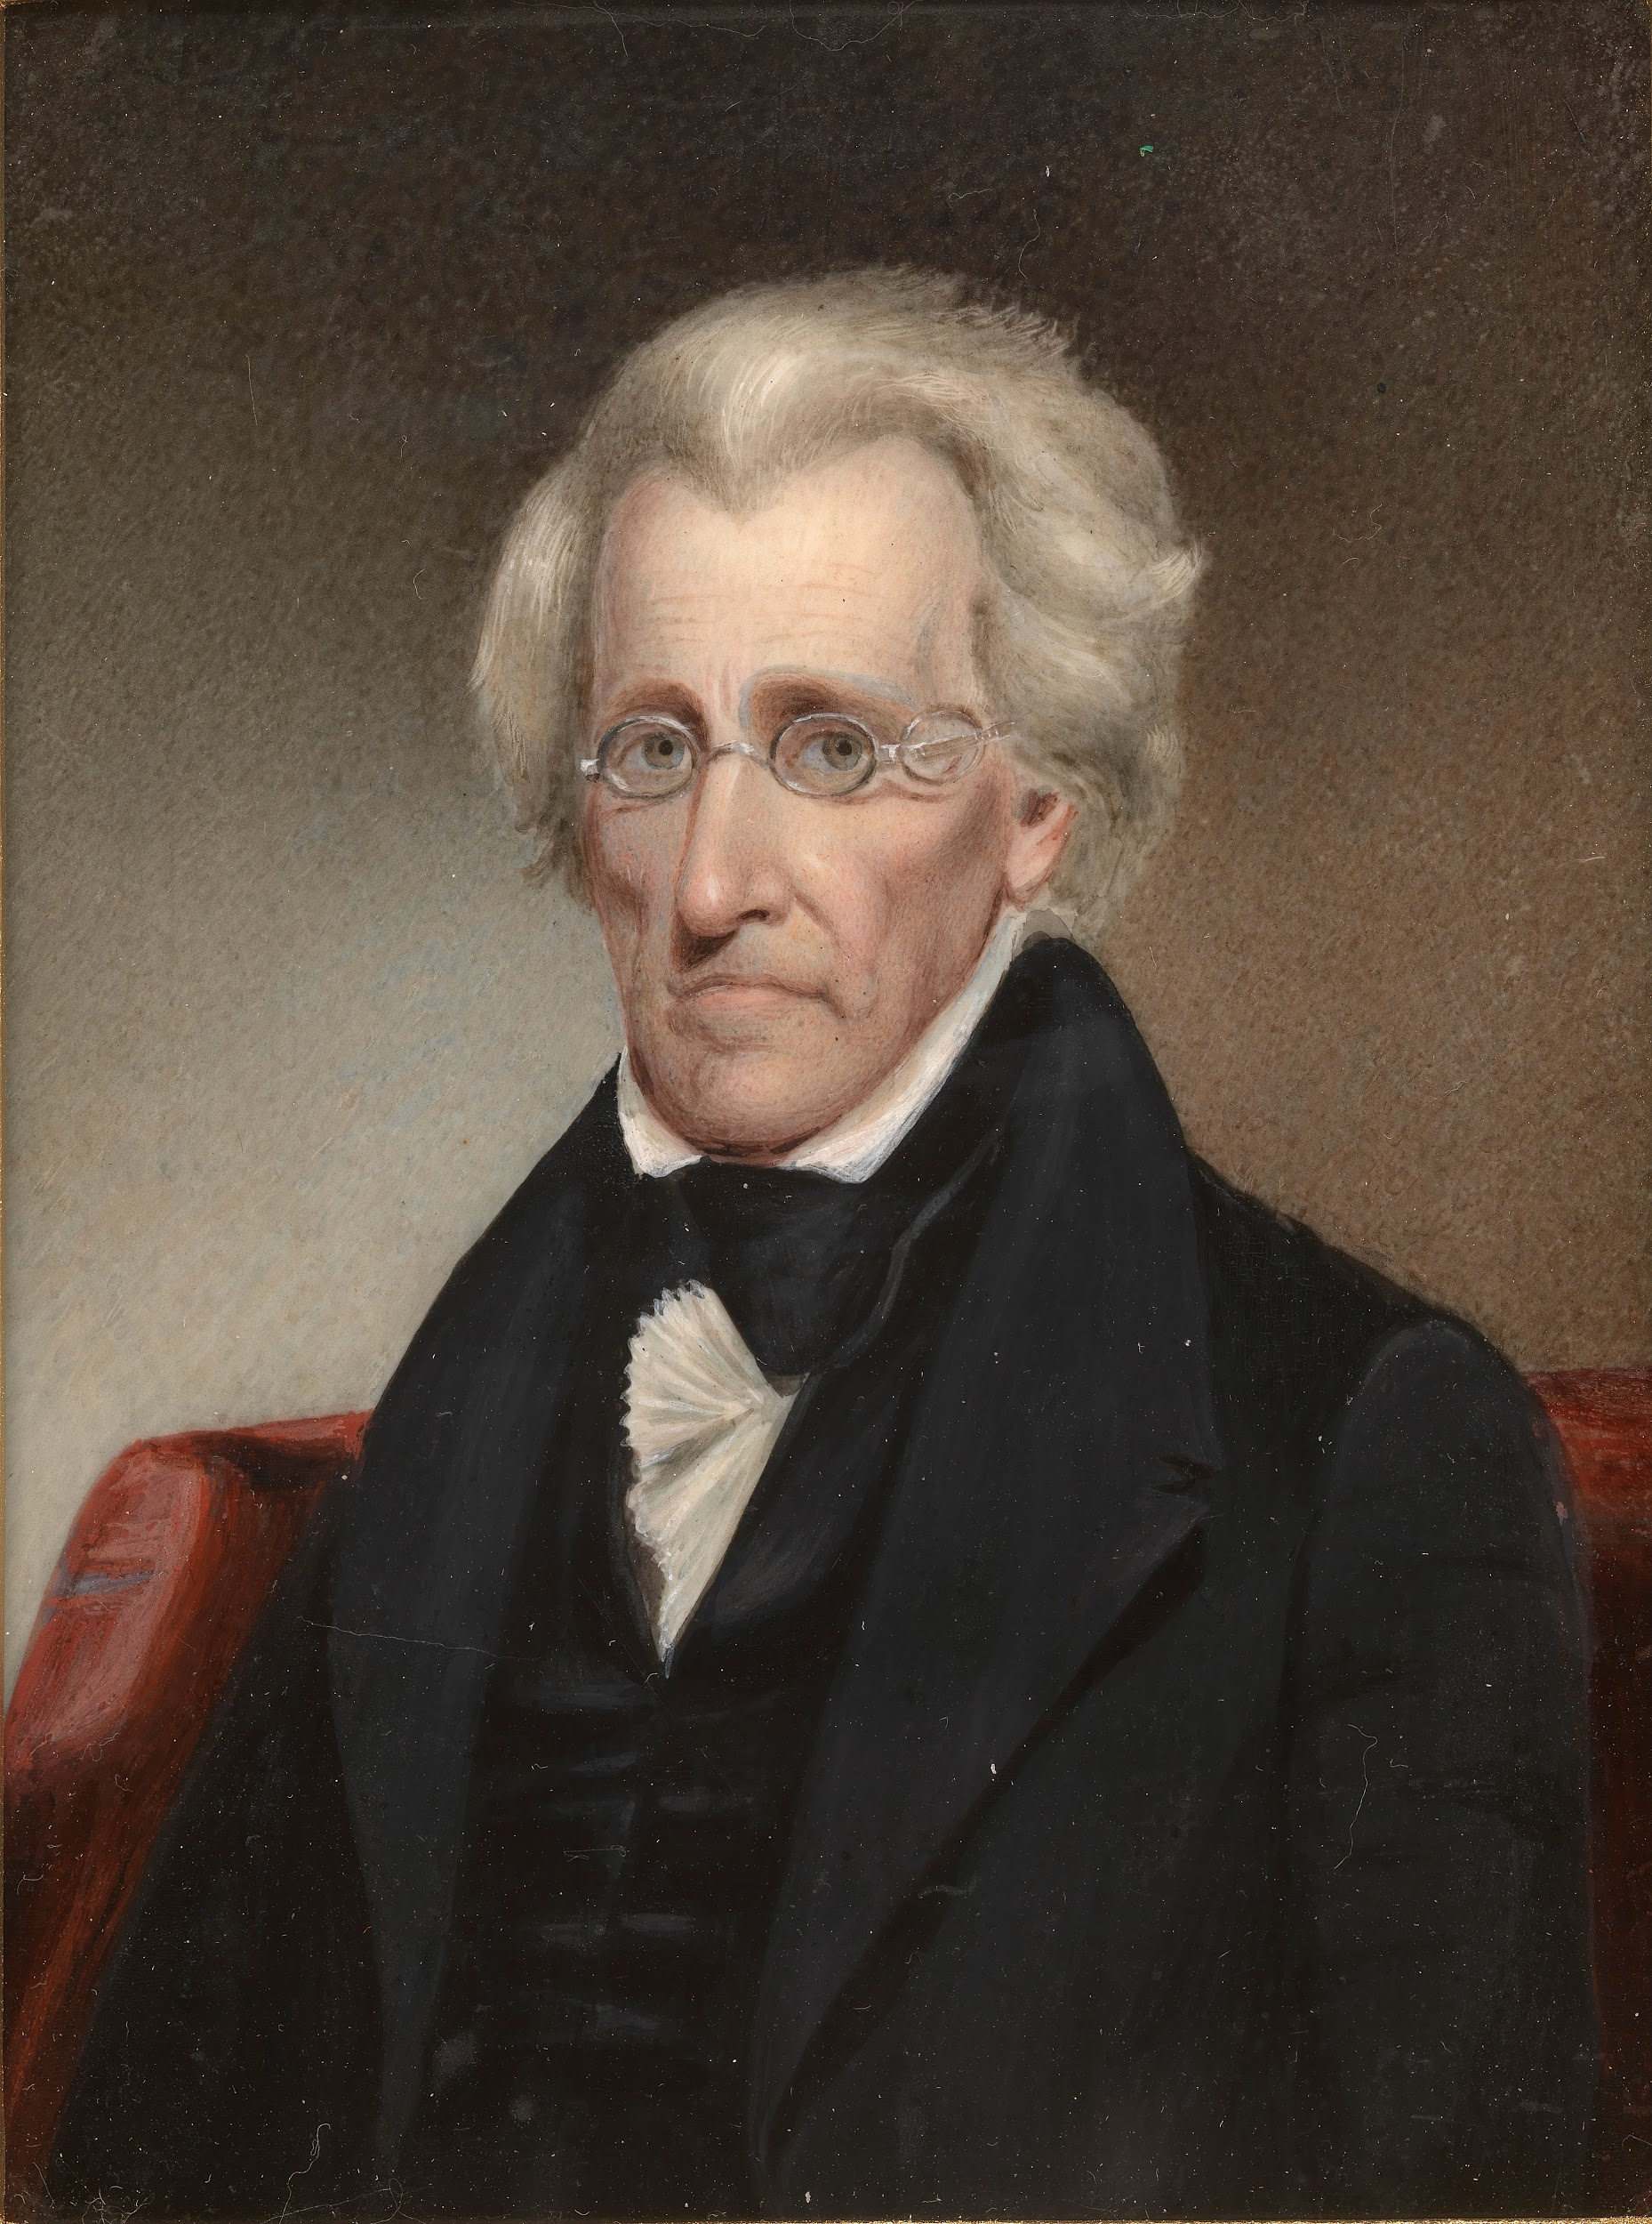
Andrew Jackson
President 1829-1837
“Democratization began/continued under him. Landowning “Jeffersonian”
Challenged “Hamiltonian” ideas of commerce and development. Opposed tariffs, debt, bank, no debt
War Hero: Battle of New Orleans and Florida Indian Wars
Ran for President in 1824: So close it was decided by the US House of Representatives
Vote for Andrew Jackson who can fight not John Quincy Adams who can write!
“King” Andrew: Expanded Executive Power
Indian Removal Act

Slide 5
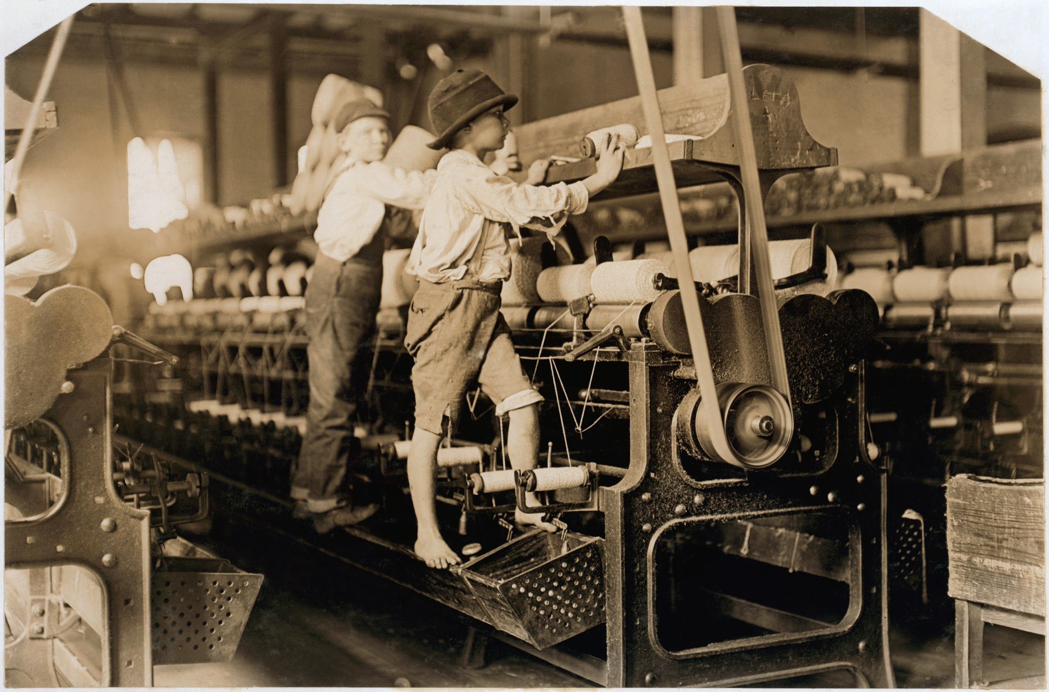
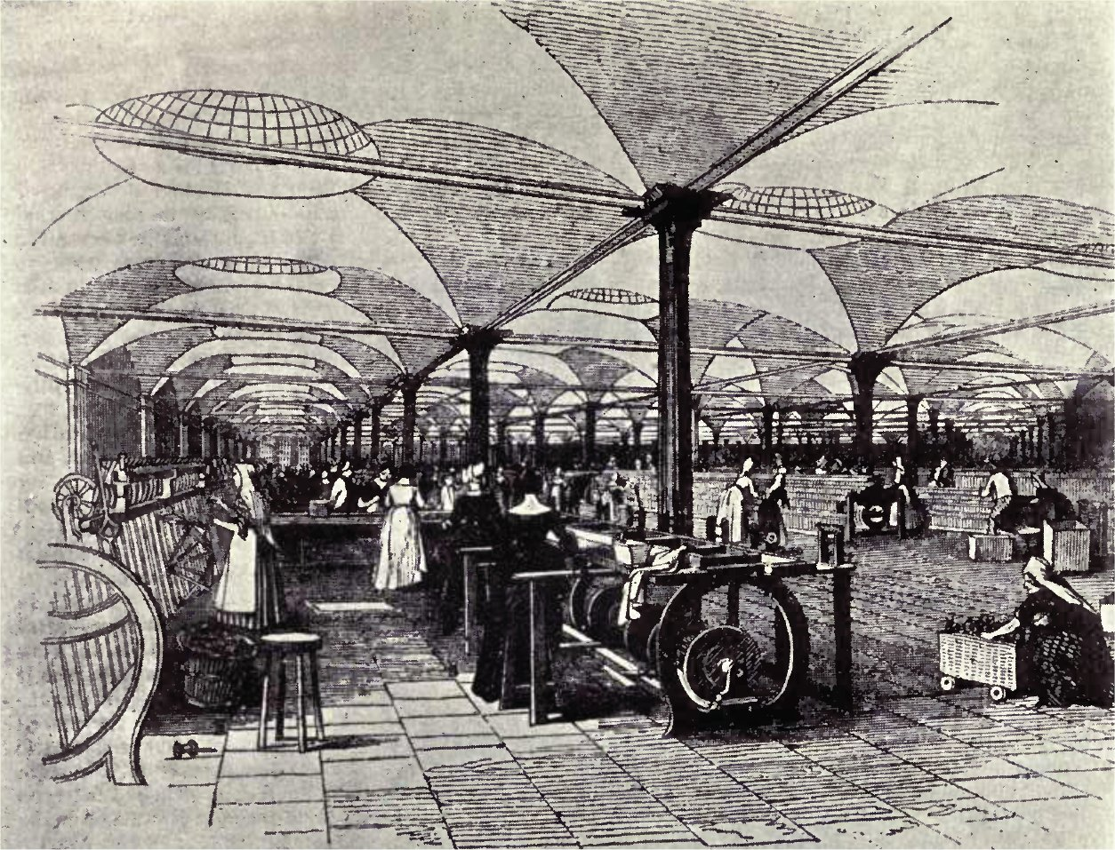
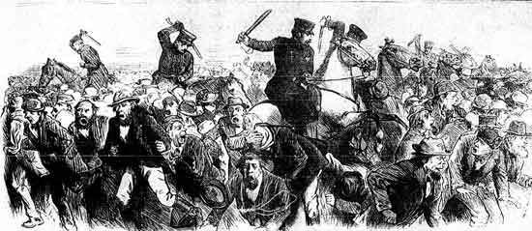
Living Conditions

Slide 6
New York City Draft Riot - (Nat. History Day Project)

Slide 7
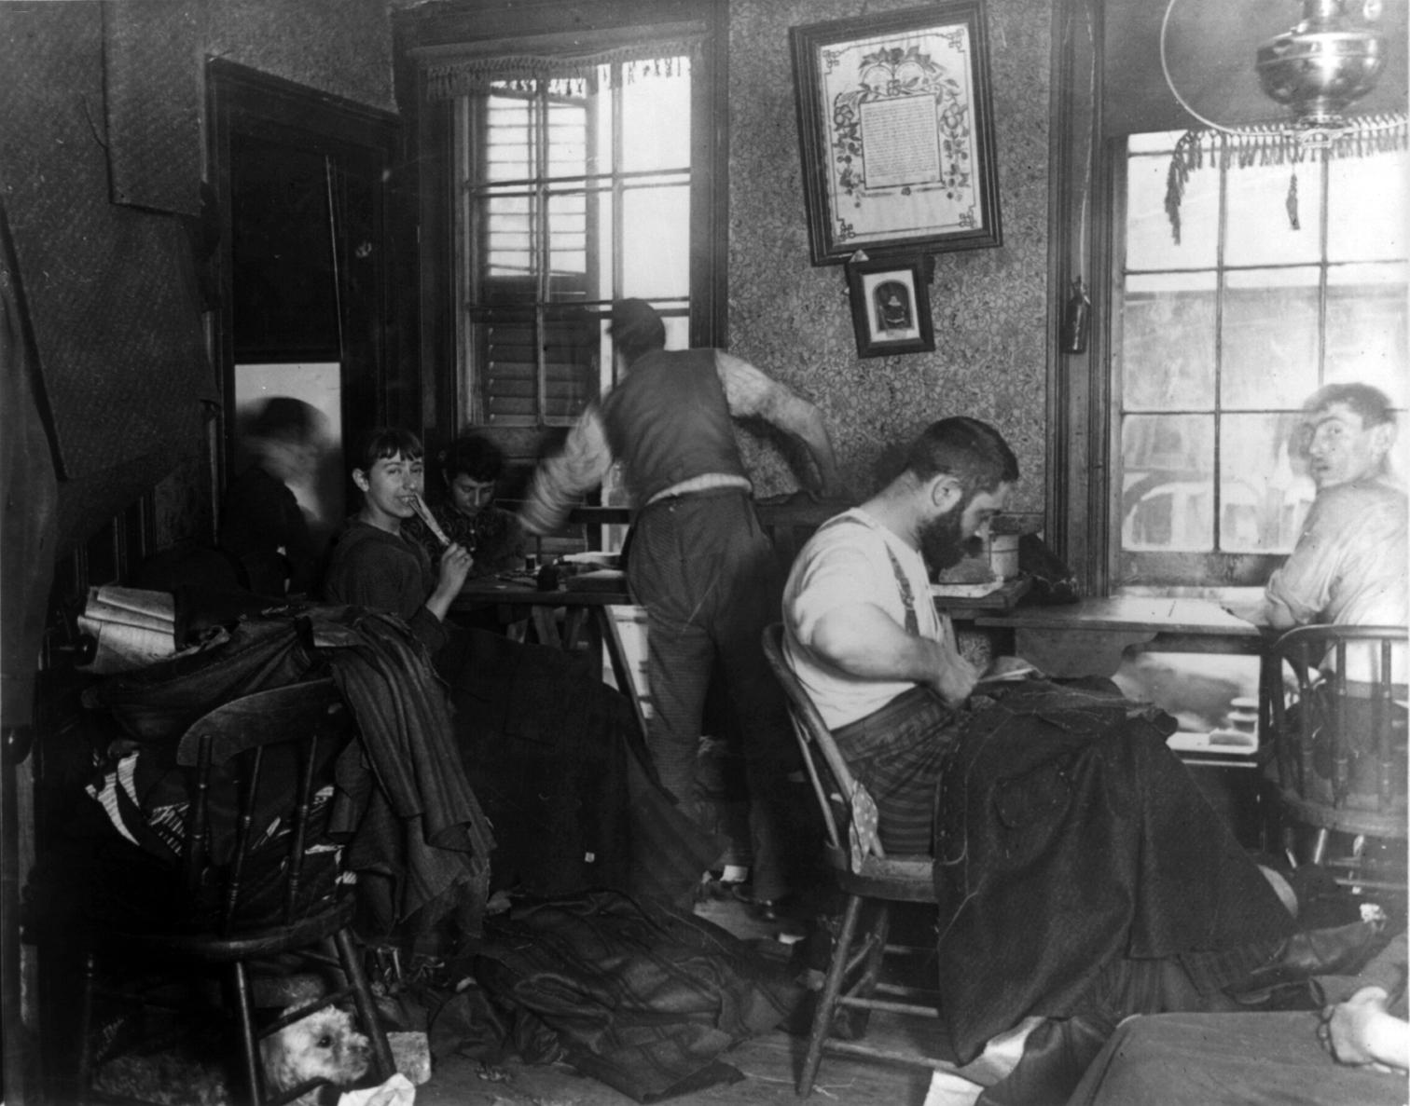
Immigration to the US
1880-Present Immigration Map

Slide 8
The Great Railroad Strike of 1877

