Slide 1
Agenda
Monday: Overview of Israel & Palestine
Tuesday: Guest Speaker
Wednesday: Iran & Alliances
Thursday: Discussion
Due Thursday: Short Response to all questions, longer responses to three

Slide 2
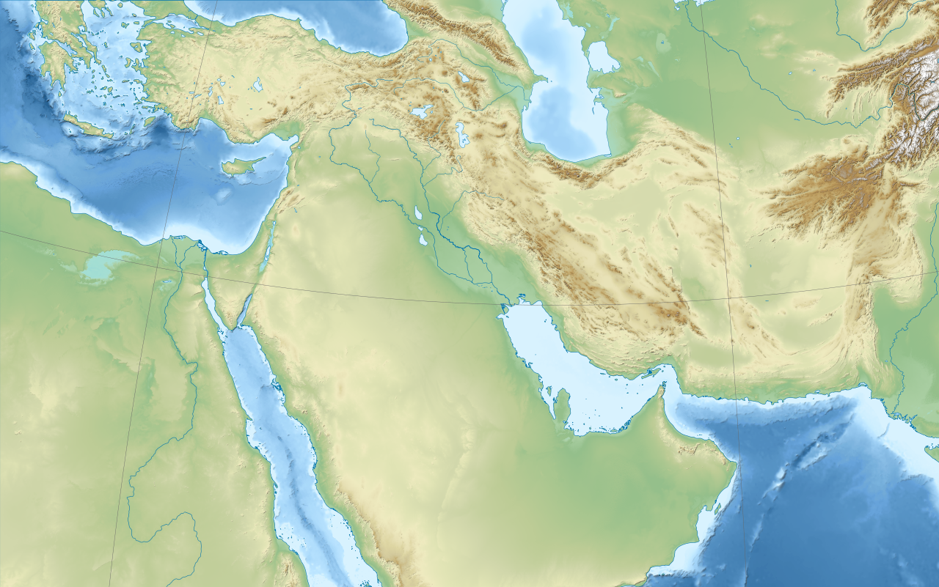
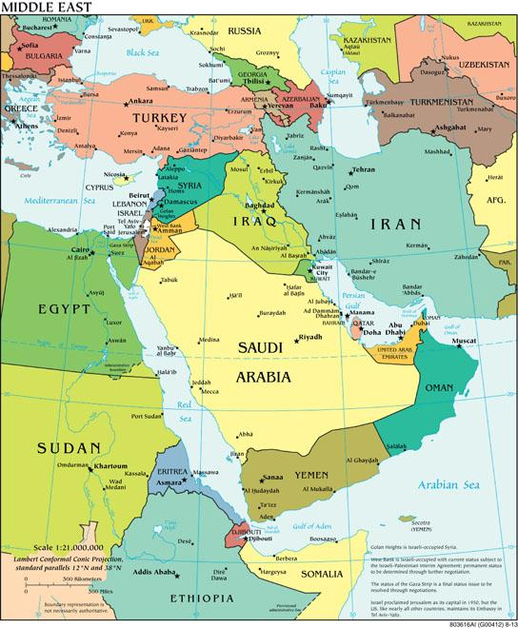
Physical & Political Maps of the Middle East

Slide 3
Crash Course:
Israel & Palestine
Key Terms:
State & Nation
Zionism
Ottoman Empire
United Nations

Slide 4
Reflection Question:
How can you describe the Israelis and the Palestinians?

Slide 5
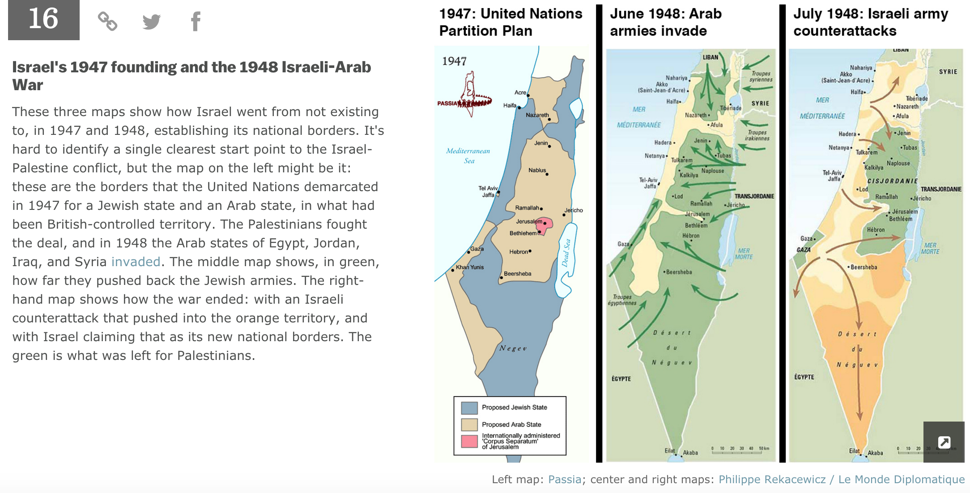
POOP

Slide 6
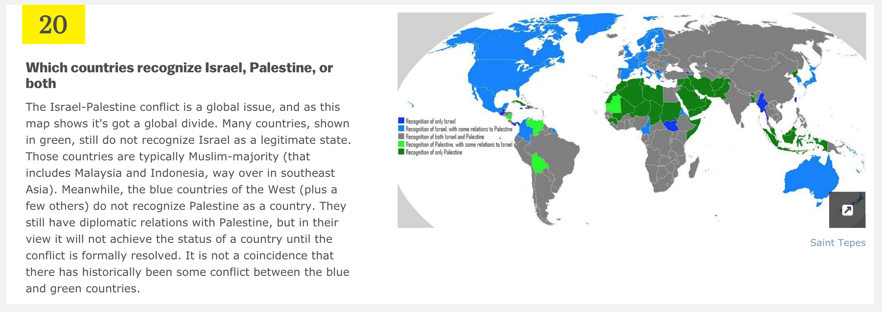

Slide 7
The Daily Show Middle East Map
http://www.cc.com/video-clips/kovgs5/the-daily-show-with-jon-stewart-sir-archibald-mapsalot-iii

Slide 8
Iran
How would you explain the Iranian Revolution?
As we discuss and watch clips today, please reflect on this overarching question and turn in a response at the end of class.
Agenda
QOD
Iran
Discussion Preparation
Future Student Projects
Due Thursday: Short Response to all questions, longer responses to three

Slide 9
Crash Course:
Iran
Key Terms:
Communism
Shah
Monarchy
Ayatollah
Autocrat

Slide 10
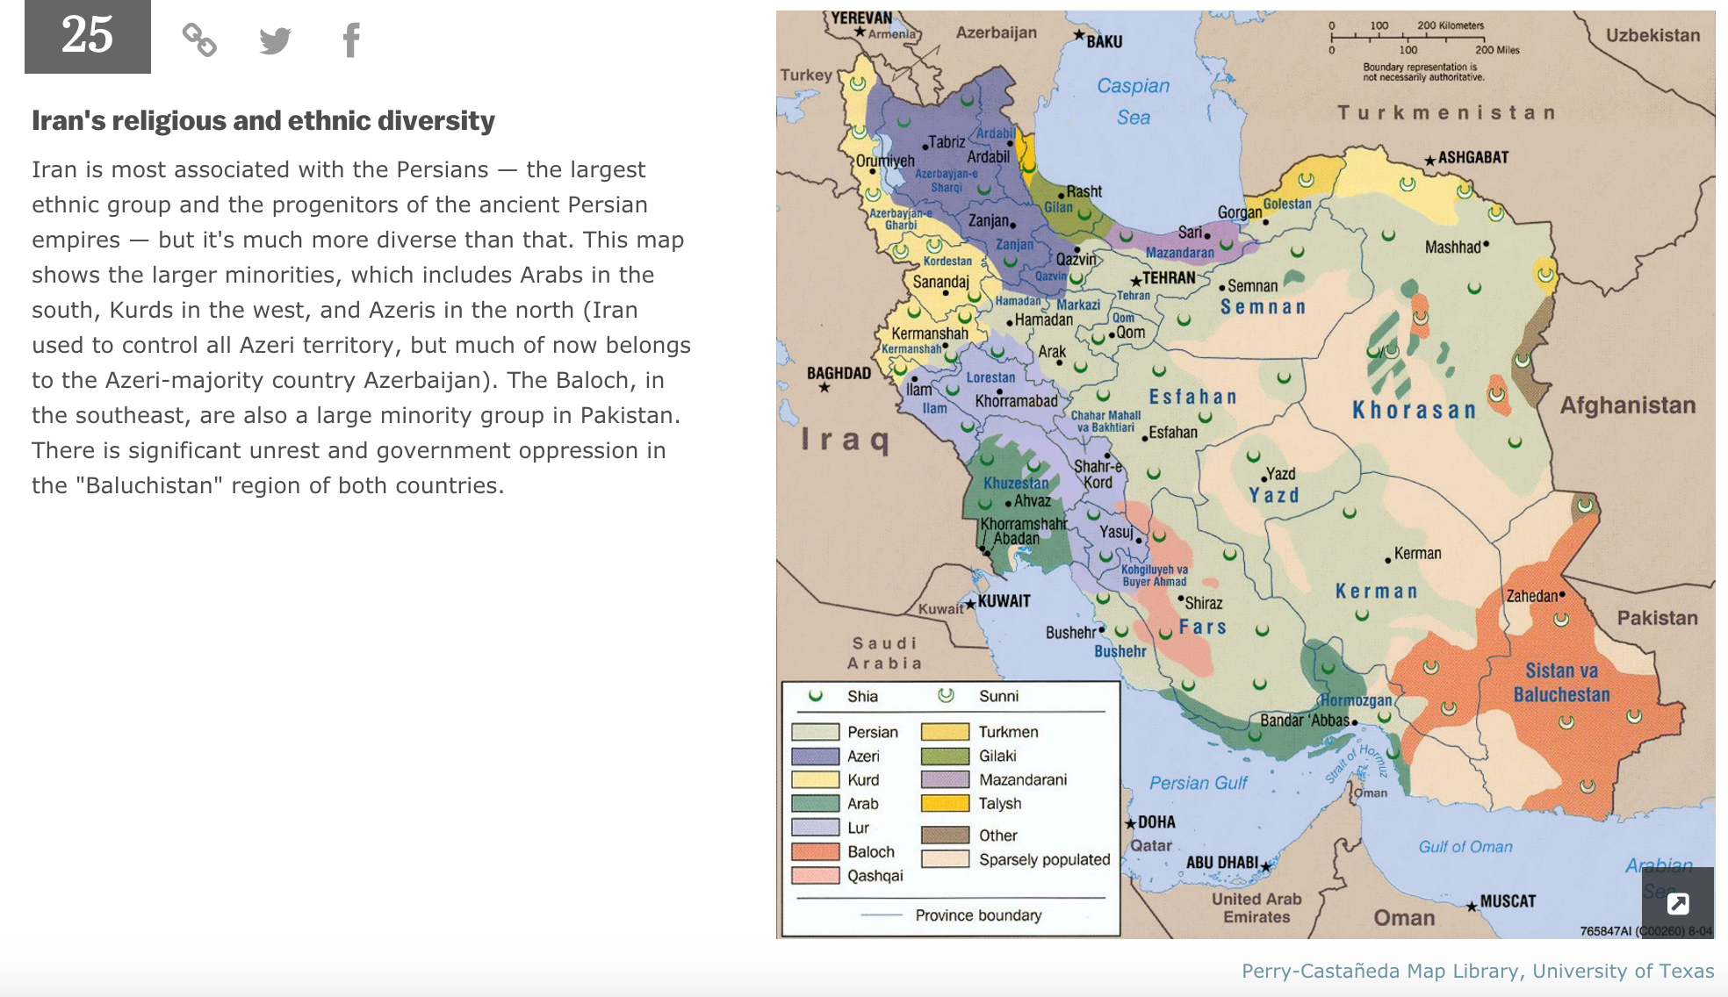

Slide 11
Iran
How would you explain the Iranian Revolution?
As we discussed and watch clips yesterday, please reflect and write on this overarching question.
Agenda
QOD
Saudi Arabia
Discussion Preparation
Future Student Projects
Due Thursday: Short Response to all questions, longer responses to three

Slide 12
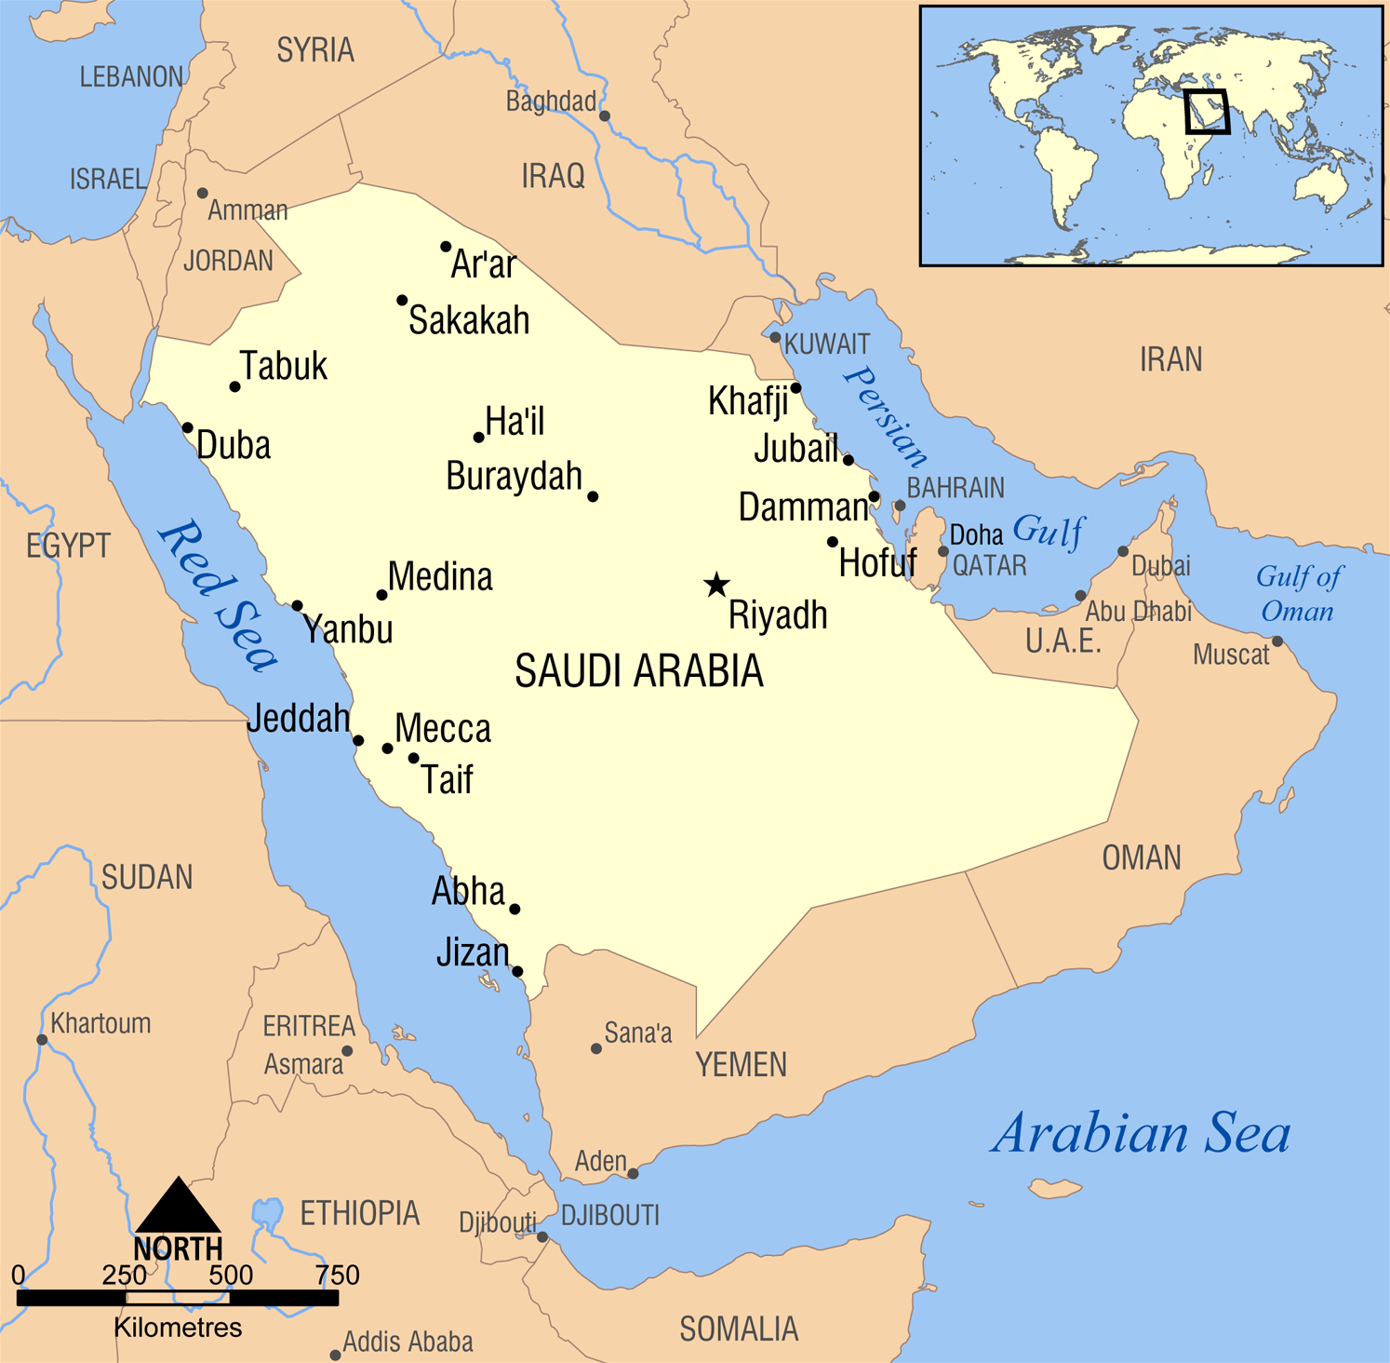
Why do these two places matter in Islam?
Mecca
Medina

Slide 13
VOX: 9 Questions about Saudi Arabia you were too embarrassed to ask
http://www.vox.com/2015/1/26/7877619/saudi-arabia-questions

Slide 14
The Daily Show Middle Alliances
http://www.cc.com/video-clips/7v01wm/the-daily-show-with-jon-stewart-middle-eastern-politics--a-love-story

